Slide 1
Face Detection Machine Learning Project
RIYA MAHAJAN
2100910130089
MINI PROJECT

Slide 2
CONTENTS
Introduction
Motivation
Innovation of Project
Scope of the Project
Open-CV Python
Face Detection
Haar Features System
Conclusion
References

Slide 3
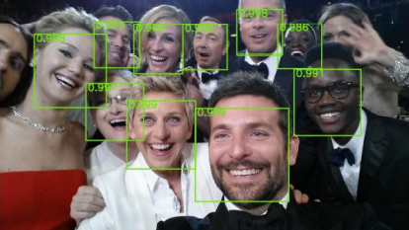
Introduction
Face detection is a computer vision technology that helps to locate/visualize human faces in digital images. This technique is a specific use case of object detection technology that deals with detecting instances of semantic objects of a certain class (such as humans, buildings or cars) in digital images and videos. With the advent of technology, face detection has gained a lot of importance especially in fields like photography, security, and marketing.

Slide 4
Motivation
We developed this Face Detection Project for our Indian Army, Security CCTV Police and even Common Use of people to detect Face in single and group of peoples in Images.
Today In world Security is advancing to detect the terrorist and criminals easily in crowd. This Project will easily detect faces even old\blur Images with very less time of execution.
This Face Detection Code can be deployed and use in any application camera, security apps and website to found faces easily.

Slide 5
Innovation Idea of Project
It can Detect faces easily with less time of execution.
It can Detect Face in any quality of Images even blur.
It can Detect single, double or even multiple faces in any Image.
It can tell the number of Peoples/faces in Image.
It is fully automatic face recognition system
It is one of the best in today world Innovation as per less number of code use in the system.
It use Haar feature based Algorithm to detect which it makes very accurate and fast processing of face detection

Slide 6
Scope of Project
To identify and verify terrorists at airports, railway stations and malls the face recognition technology will be the best choice in India as compared with other biometric technologies since other technologies cannot be helpful in crowded places.
This technology can also be used effectively in various important examinations such as SSC, HSC, Medical, Engineering, MCA, MBA, B- Pharmacy, Nursing courses etc. The examinee can be identified and verified using Face Recognition Technique.
It can also be deployed in police station to identify and verify the criminals.
To Identify the Number of student in classroom. It can collect in all the number of faces in less than 1 sec. Easy to take attendance.

Slide 7
OpenCV-Python
OpenCV essentially stands for Open Source Computer Vision Library. Although it is written in optimized C/C++, it has interfaces for Python and Java along with C++. Open CV boasts of an active user base all over the world with its use increasing day by day due to the surge in computer vision applications. Open CV-Python is the python API for Open CV. You can think of it as a python wrapper around the C++ implementation of Open CV. OpenCV-Python is not only fast (since the background consists of code written in C/C++) but is also easy to code and deploy(due to the Python wrapper in foreground). This makes it a great choice to perform computationally intensive programs.

Slide 8
Installation
OpenCV-Python supports all the leading platforms like Mac OS, Linux, and Windows. It can be installed in either of the following ways: Packages for standard desktop environments (Windows, macOS, almost any GNU/Linux distribution)
run pip install opencv-python if you need only main modules
run pip install opencv-contrib-python if you need both main and contrib modules

Slide 9
Face Detection
Face detection is a technique that identifies or locates
human faces in digital images. A typical example of face
detection occurs when we take photographs through our
smart phones, and it instantly detects faces in the picture.
Face detection is different from Face recognition. Face
detection detects merely the presence of faces in an image
while facial recognition involves identifying whose face it is.
In this article, we shall only be dealing with the former.
Face recognition is the task of identifying an already
detected object as a known or unknown face. Often the
problem of face recognition is confused with the problem
of face detection Face Recognition on the other hand is to
decide if the "face" is someone known, or unknown, using for this
purpose a database of faces in order to validate this input face.

Slide 10
Face Detection Classifiers
Face detection is performed by using classifiers. A classifier is essentially an algorithm that decides whether a given image is positive(face) or negative(not a face). A classifier needs to be trained on thousands of images with and without faces. Fortunately, OpenCV already has two pre-trained face detection classifiers, which can readily be used in a program. The two classifiers are:
Haar Classifier and
Local Binary Pattern (LBP)
For this Project, Will only discuss the Haar Classifier for Face Detection as it best method for detection.

Slide 11
Haar feature-based cascade classifiers
Haar-like features are digital image features used in object recognition. They owe their name to their intuitive similarity with Haar wavelets and were used in the first real-time face detector. Paul Viola and Michael Jones in their paper titled "Rapid Object Detection using a Boosted Cascade of Simple Features" used the idea of Haar-feature classifier based on the Haar wavelets.
This classifier is widely used for tasks like face detection in computer vision industry.
Haar feature-based cascade classifiers is an effectual machine learning based approach, in which a cascade function is trained using a sample that contains a lot of positive and negative images. The outcome of AdaBoost classifier is that the strong classifiers are divided into stages to form cascade classifiers.

Slide 12
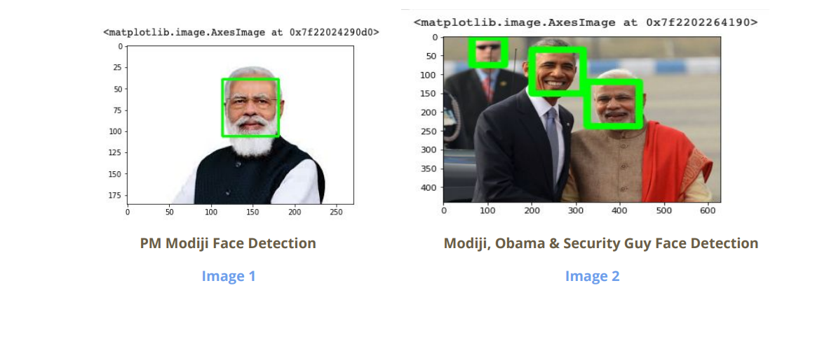
Sample Outputs

Slide 13
Conclusion
Face recognition technologies have been associated generally with very costly top secure applications. Today the core technologies have evolved and the cost of equipments is going down dramatically due to the integration and the increasing processing power. Certain applications of face recognition technology are now cost effective, reliable and highly accurate. As a result there are no technological or financial barriers for stepping from the pilot project to widespread deployment.
Government and NGOs should concentrate and promote applications of facial recognition system in India in various fields by giving economical support and appreciation.

Slide 14
References
http://umpir.ump.edu.my/id/eprint/327/3/Real%20time%20face%20detection%20system%20-%20Chapter%201.pdf
https://www.sciencedirect.com/topics/computer-science/classifier-cascade
https://ieeexplore.ieee.org/document/6315916
https://link.springer.com/chapter/10.1007/978-3-642-72201-1_9
https://thesai.org/Downloads/Volume9No6/Paper_6-Study_of_Face_Recog nition_Techniques.pdf
http://www.pace.ac.in/documents/ece/FACE%20RECOGNITION%20SYSTEM%20WITH%20FACE%20DETECTION.pdf

